Slide 1
Managing Stakeholders, as a matter of Mission
A lecture at the Lagos Business School, on 25 February 2016
by Chude Jideonwo
Managing Partner, RED (www.redafrica.xyz)

Slide 2
The first thing to note is…
Corporations and NGOs are very different in their goals, organization structure, motivating factors and culture. They enter into relationships with each other with differing objectives

Slide 3
What are these objectives?
According to the Corporate-NGO Barometer 2015:
  96% of corporates enter partnerships to enhance reputation
  98% of NGOs enter partnerships to access funds
  83% of NGOs enter partnerships for access to people and contacts

Slide 4
Corporates are more strategic
However:
  40% of NGOs classify >50% of their partnerships as strategic
  71% of corporates classify >50% of their partnerships as strategic
What is the reason for this gap?

Slide 5
The first question I get from NGOs is…
How can I get funding?
It is the wrong question.

Slide 6
These questions are much more important
Is the impact of my NGO’s work so strong that anyone looking at it will have no choice but to fund it?
How compatible are the goals, sensibility and cultures of my NGO with the organisation I want to approach?
Are there mutually accepted metrics to gauge the success of the relationship and its impact?
Does the relationship lead to tangible business value for the company and measurably contribute to the NGO's social purpose?
To what extent is the relationship dependent on personal connections and chemistry among key individuals?
Given the differences in time horizons and potential shifts in priorities -- particularly from the corporate side because of budgetary or business cycles -- does this prevent the relationship from developing into a longer-term, more "strategic" one?

Slide 7
It bears repeating
Funders are not your only stakeholders, nor are they in fact your most important subset.

Slide 8
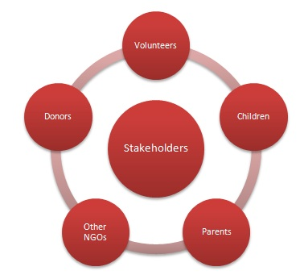

Slide 9
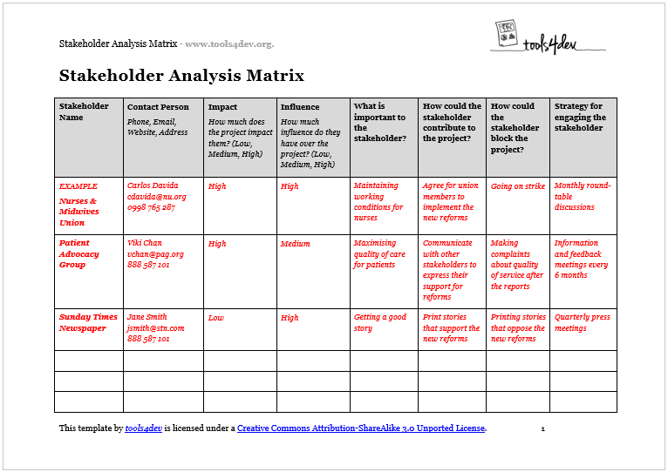

Slide 10

#IyalayaAnybody
Hits Back to Back

Slide 11
(PAUSE.)

Slide 12
Seek ye first…
Apply the same principles of marketing:
  Value proposition
  Product strategy
  Who is the customer?
You are selling a product. The product is Empowerment. Would you buy your product?
A clear vision eliminates distractions in pitches and chasing funding

Slide 13
…And all other things will be added
If you have built what you are doing into something powerful, with impact, a sense of mission, that’s the most important tool for building relationships. Everything else will come.
Not automatically, but organically.

Slide 14
How to build those relationships
#StopHustling #StartGrowing
Can you first 10 slides of a presentation show impact that can convince anyone?
Build a network – without looking like a networker
Build a force-field of goodwill that can serve as bulwark when things go wrong (they will, organisations in this era are treated like human beings)
What’s the (long-term) plan?

Slide 15
Building relationships: Tactical considerations
Do your primary stakeholders – your team – believe in what you are doing?
Do you believe in what you are doing?
Don’t look like a high-way robber.
Deliver what you promise
Speak only about what you know.
Don’t keep changing your strategy to fit the stakeholder – as a strategy

Slide 16
Building relationships: Tactical considerations
Do due diligence to ensure that values are aligned. Not every corporate organisation or rich man is a potential partner.
Once secured, frequent updates on activities in between reporting times is very beneficial.
Stakeholders are human beings. They know you want something. But the HOW is crucial.
Do not underestimate the value of counsel, of brain storming, of peer review.
Do not underestimate the value of anyone.

Slide 17
You are in this for a reason: the reason is to change lives, or societies.
If you believe in it, and have thought through it, proceed with confidence.

Slide 18
THANKYOU

