Slide 1
Increasing social media engagement
by Joachim MacEbong
For Redux Digital
Presented at the Advanced Media Management and Writing in a Digital Age (AMDA) course at the School of Media Communication, Pan-Atlantic University, on March 16, 2016.

Slide 2
Choose your tribe
Always look for other platforms through which users can be engaged. Try thinking beyond the regular FB/Twitter/Instagram.
Engagement is very important and usually more important than the number reached. Finding ways to get users liking, commenting, retweeting, is key.
Interactive content formats such as: questions, polls and quizzes are the future of engagement.

Slide 3
Choose your tribe
Videos get massive engagement rates and should always be incorporated. Users watch large volumes of video and are always looking for more to consume.
Using a call to action (‘Retweet’, ‘Share your thoughts’, ‘Click here’) can sometimes increase engagement rates by up to 100%.

Slide 4
The power now lies with the audience
Post more than once
Tweak your headlines
Tailor your content to the platform: Twitter (snark, wit) Instagram (beauty, richness)

Slide 5
Collaboration
Using established influencers to get a new brand off the ground
Who are your target influencers?

Slide 6
Measure, measure, measure
Keep an eye on metrics and numbers to know what works
Keep testing and move fast

Slide 7
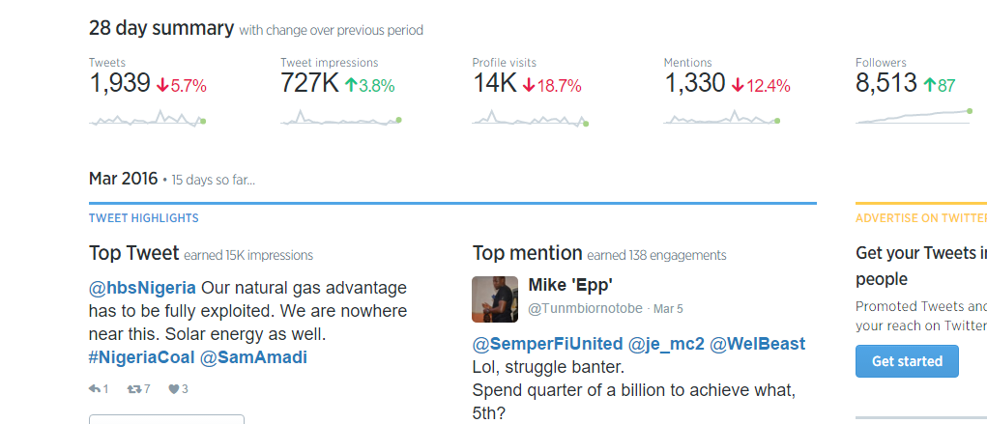
Twitter Analytics

Slide 8
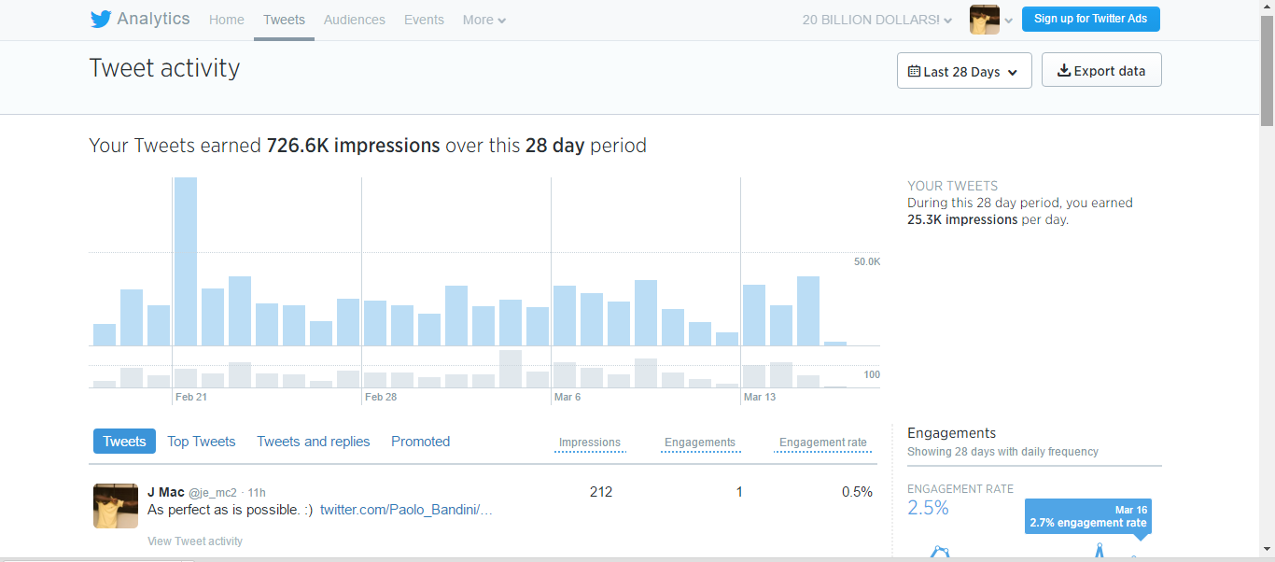
When is your audience online?
The higher your impressions, the more of your audience is online. Target those time belts for posts and watch over a period

Slide 9
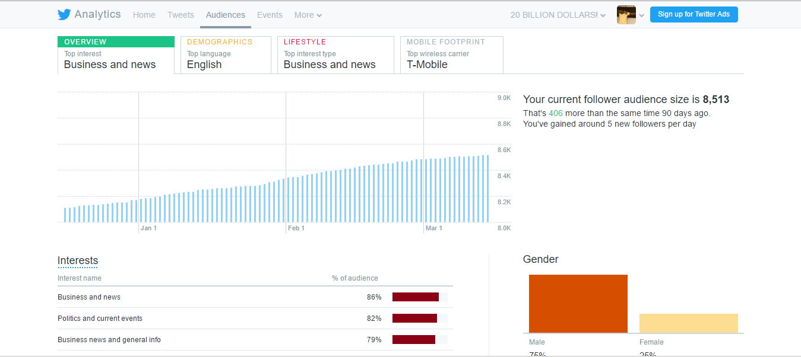
Audience insights

Slide 10
Expanding reach on Facebook
Videos
Pictures
Text
Infographics.

Slide 11
Funny content that gets people sharing, works everywhere.
Using influencers may not be necessary if your content is solid

Slide 12
Hashtags
Tweets with hashtags receive 2x more engagement than those without hashtags
This is especially true when the hashtag is a trending topic
#Nigeria
#BuyNaijaToGrowTheNaira

Slide 13
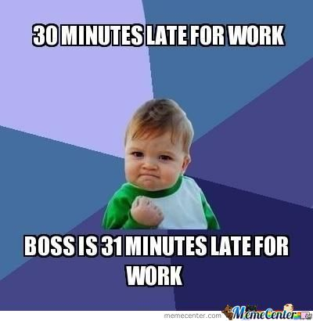
Use pictures, memes
An image attached to any tweet is sure to increase visibility and engagement.
The last 18 months has seen an explosion of pictures with funny captions, known as memes

Slide 14
Videos, too!
There has also been an explosion of video content on social networks.
For example, Facebook prioritises video content in its news feed

Slide 15
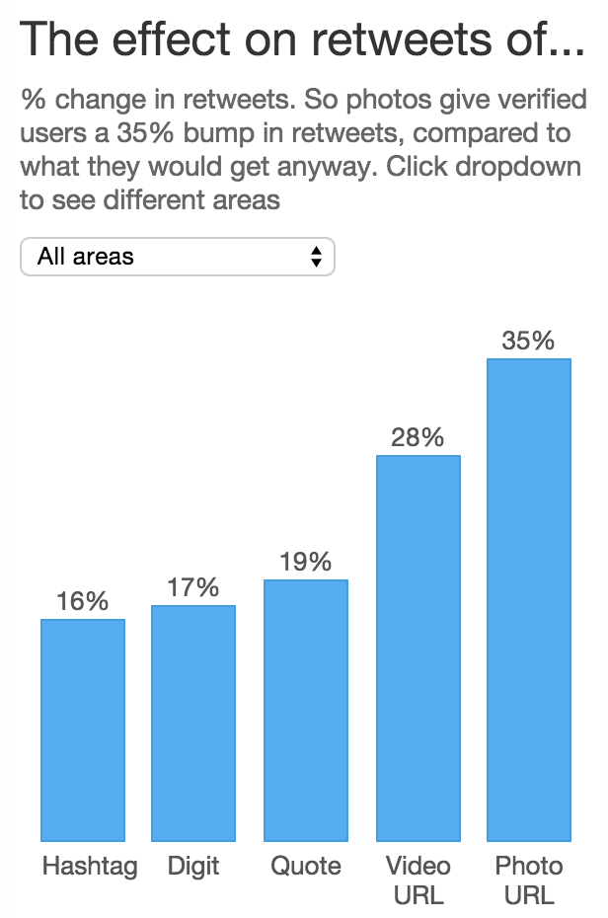

Slide 16
Reply people often
Just like in real life, it is rude for people to speak to you online and go without a reply. You can’t reply everyone, but do as many as you can.

Slide 17
THANKYOU

