Slide 1
The Future Awards Africa Story:
Growing an Africa Brand for the rest of the world.
By Bukonla Adebakin
Deputy Chief Operating Officer, The Future Project

Slide 2
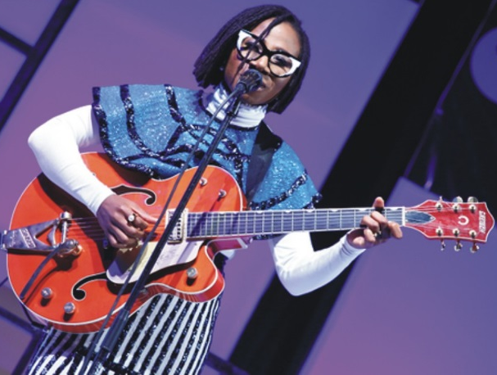
The Vision
In 2005, The Future Project was founded with the aim of raising empowered citizens.. The Future Project is the largest home-grown network of policy-makers, business people, and other stakeholders in Young Africa.
Through The Future Awards, we wanted to give African youths a voice. We wanted to show the possibilities that exists in Africa. We wanted to share the brilliant stories of young Africans who were doing amazing stuff in Entertainment, Arts, Culture, Business, Health, Agriculture etc, we wanted to show the world the beauty of Africa, and over the past 12 years, we have created a new narrative, a new reality.

Slide 3
Creating A New Reality
We engage more than 30 million young Nigerians every year, and we continue to inspire leadership and build enterprise amongst Africans youth. Over the past decade, the Future Awards has been hard at work looking for the stories that resonates with the African, and sharing these stories with the public has helped to shape the perception of the world about the innate ingenuity, creativity, brilliance and beauty of an average African.
We have helped a generation find its voice and we have given thousands of Africans the opportunity to see that life is a process, and that creating a new reality for us all is the best way to take Africa’s brand to the world, as we have done over the past 12.

Slide 4
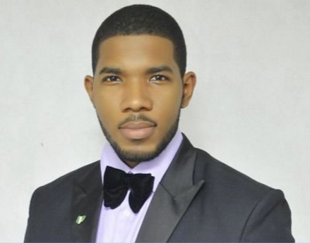
Raising Giants
Otto Orondam is the founder, Slum2School a project designed to place children without means, into schools. What was a pet project has now grown into a full scale volunteer driven organization. The organization has provided education support to over 600 disadvantaged children living in slums. He has helped bring the focus to thousands of less privileged young Nigerians.
Otto Orondam was the recipient of The Future Award Africa prize for Innovator of the Year(Education) in 2013

Slide 5
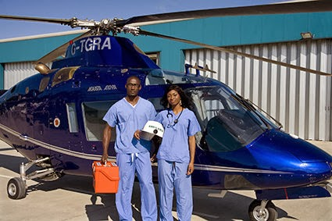
Raising Giants…Cont’d
Ola Orekunrin is a Managing director of Flying Doctors Nigeria; a charity based in Lagos Nigeria. She was the recipient of The Future Awards Africa prize for Entrepreneur of the year in 2012. She created a service that has revolutionized healthcare services in the country

Slide 6
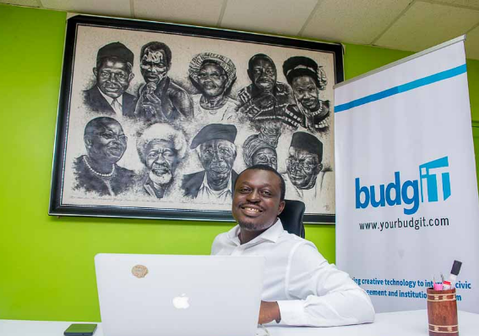
Raising Giants…Cont’d
Seun Onigbinde is the co-founder and CEO of BudgIT, a Nigerian civic startup. Oluseun Onigbinde is a fiscal transparency advocate and firm believer in the power of Open Data. He has helped used data
He won the Future Award prize for Innovator of the Year (Science & Technology) in 2012.
He has through BudgIT been able to increase the consciousness of Nigerians about the issue of accountability in governance by Nigerian leaders.

Slide 7
Inspiring Africa
Otto Orondam, Seun Onigbinde and Ola Orekunrin are just 3 of the past 209 winners of the awards.
They are part of the 1291 nominees that have been selected over the years to represent Africa’s best youths. They have shown the world the possibilities that exists in the continent. These ones have provided inspiration for young Africans who look up to them, and who can through their stories, continue to light the fire of the dreams that they have.
These ones have paved the way, shattered barriers, and broken the ceilings, that
has limited Africans both mentally and physically for decades.
The alumni of The Future Awards have kept the flag flying from Senegal to Cameroun, to Nigeria, to Ghana, they have helped mentor thousands of African youths who need direction and guidance to achieve their potentials.
This is the good news of The Future Project

Slide 8
IMPACT

Slide 9
The Future
Eleanor Roosevelt once said: ‘’The Future belongs to those who believe in the beauty of their dreams ‘’ and The Future Awards is committed to creating the enabling environment for young Africans to fulfil their grand potentials, and to showcase them to the world.
ACCOLADES
“Noble Prize for Young Africans”
“Biggest youth award in Africa”
“Nigeria’s most important youth award”

Slide 10
Lessons from the Journey
Dream Big. Start small then go global #gobigorgohome
Leverage on Organizations with similar visions. Collaborate. Volunteer.
Have a long term perspective (Ask yourself; How will my vision be impacted by changes in the future?)
Never stop believing in your ability to cause change. #Believeinyourself #Keeppushing

Slide 11
THANK YOU

