Slide 1
Before ‘youth’ becomes a powerless cliché:
Charging a practical media-driven course for Africa’s demographic bulge.
Chude Jideonwo
Managing Partner, RED
28-31 July, 2017
Africa Union Commission, Addis Ababa

Slide 3
The reality we face
Between 2000 and 2008, Africa created 73million jobs, but only 16 million for young people.
International Labour Organisation

Slide 4
The reality we face
Africa’s youth comprise of 60 percent of Africa’s unemployed, compared to a 44% global average.
African Economic Outlook

Slide 5
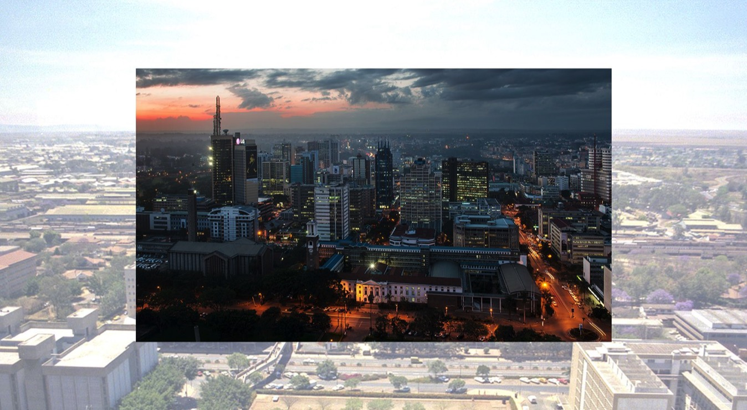

Slide 6
The reality we face
Two-thirds of all young workers in the sub-Saharan labor market—95 million people—lack the basic skills needed to be competitive. What’s more, unemployment rates for graduates are often high.
The World Bank

Slide 7
Not sounding like good news?
There’s a strong likelihood that Africa in planning for its future, has forgotten about its future - or at least the citizens that will comprise of the continent in the immediate future.

Slide 8
Nevertheless
Youths are integral, nowhere more than in Africa because of their strong numbers.
The continent faces a deluge of problems that have hampered its development, chief among them is the perpetual disregard and constant underestimation of its youthful populace.

Slide 9
However,
It also makes them a lot more vulnerable to the problems that the continent faces.
Lack of effective democracies
Unemployment
Wide spread human rights violations
Unjust states

Slide 10
Despite this,
A sliver of light from youth power shines throughout the length and breadth of the continent.
From elections to protests against draconian government policies.
Africa’s youth have been at the forefront of driving social change

Slide 11
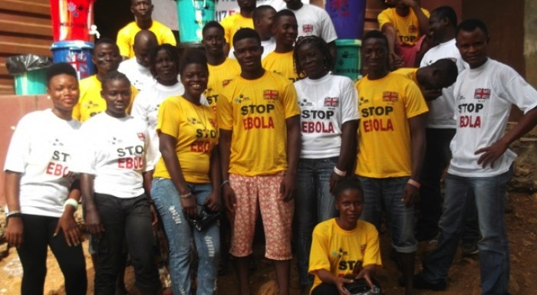
Ebola

Slide 12
Ebola
The Ebola outbreak in 2014, rapidly became the deadliest occurrence of the disease since its discovery.
The role of the youtful populations of the affected areas in alleviating and eventually stemming the spread.

Slide 13
Ebola
From countering myths (Ebola Facts)
To reporting key infromation from relief workers to victims and vice versa (Plan International)
Assesment and distrbutions of relief items to those affected by the crisis.
Psychosocial support to other youths in affected countries.

Slide 14
Cameroon Internet shutdown
Earlier this year, the Cameroonian government shut down internet access to two anglophone regions of the country.
Rather than resorting to self pity or violence, young tech. developers, creating an internet refugee camp.

Slide 15
Cameroon Internet Shutdown

Slide 16
Iroko TV
Iroko TV is a web platform that provides paid for Nigerian films on demand.
It is one of Africa’s first mainstream online websites.
The company has in total raised $25 million.

Slide 17
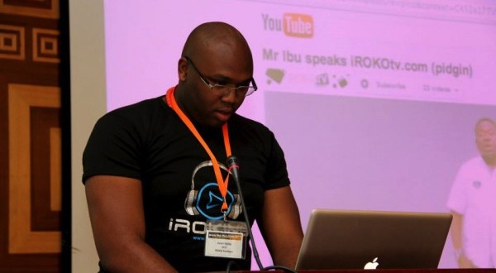
Iroko TV

Slide 18
Rebuilding Democracy
An African youth renaissance powered by democratic revolutions they’ve seen across the world (Arab Spring) have seen the benefits of effective democracies on the citizens within those systems.
Within the last 3 years, we’ve seen the youth populace, demand for changes from/of their leaders.
They have shown little or no hesitance to vote and campaign against long term leaders (Gambia, 2016) and hegemonic parties (Nigeria, 2016).
They have been successful in using the democratic process to ensure accountability for leaders via the ballot box.

Slide 19
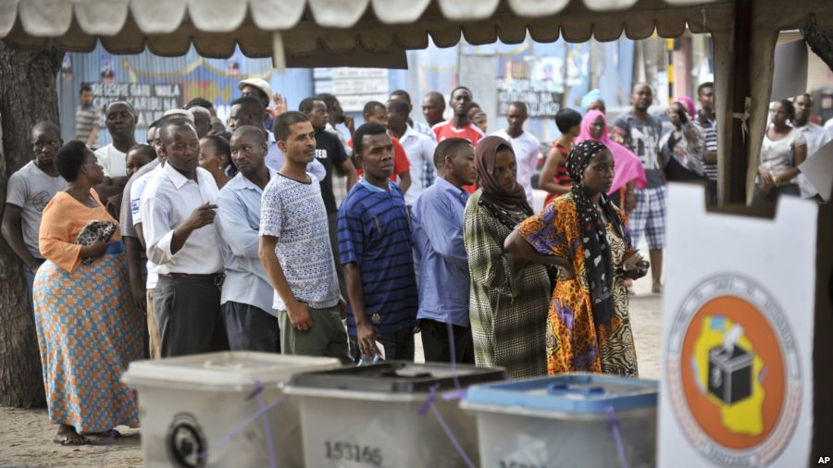

Slide 20
Positive trends in African Youths
Entrepreneurship – Whilst the large number of unemployed youths is a problem, the solution being undertaken by youths across the continent has increasingly been founding new businesses to tackle challenges that they face.

Slide 21
Political Participation
The existence of a new breed of Africans who have been exposed to the failings of leaders and have felt the brunt of their bad decisions or indecisions have led to a no nonsesnse stance to bad governance.

Slide 22
Technology
Between the last 12 months, Mark Zuckerberg – Facebook founder and CEO; Sundar Pichai, CEO of Google have paid visits to the fast growing tech clusters on the continent.
These clusters span far and wide across the continent and the increasing collaboration within them brings much hope to the future of this ecosystem.

Slide 23
What does Africa’s youth population mean for it’s stability?
Its easy to assume that its all sunshine and rainbows with the positive trends and case studies highlighted above.
However, we should be careful not to extrapolate on a few successes tha thave occurred despite and not as a result of the systems they exist in.

Slide 24
Let us note
Narratives on the proposed role of African youths are often imposed on them by external actors.
The simple existence of the youth demographic does not automatically translate into a boon for the continent.
We need to get involved in practical, proactive and purposeful ways. That is why we’re here.

Slide 25
THANK
YOU

