Slide 1
Interrogating Faith
Why does the influence of religion endure?
Chude Jideonwo & Abdul-Rehman Malik, Yale Greenberg World Fellows 2017

Slide 2
“Fear is the cheapest room in the house," the mystic Hafiz advised his friend.
"I would like to see you living in better conditions.”

Slide 3
Rethinking the Process
Trying to Model a Better Conversation about Religion
3 Interrogations

Slide 4
The First Interrogation
To what extent has religion been the driver of human conflict?

Slide 5
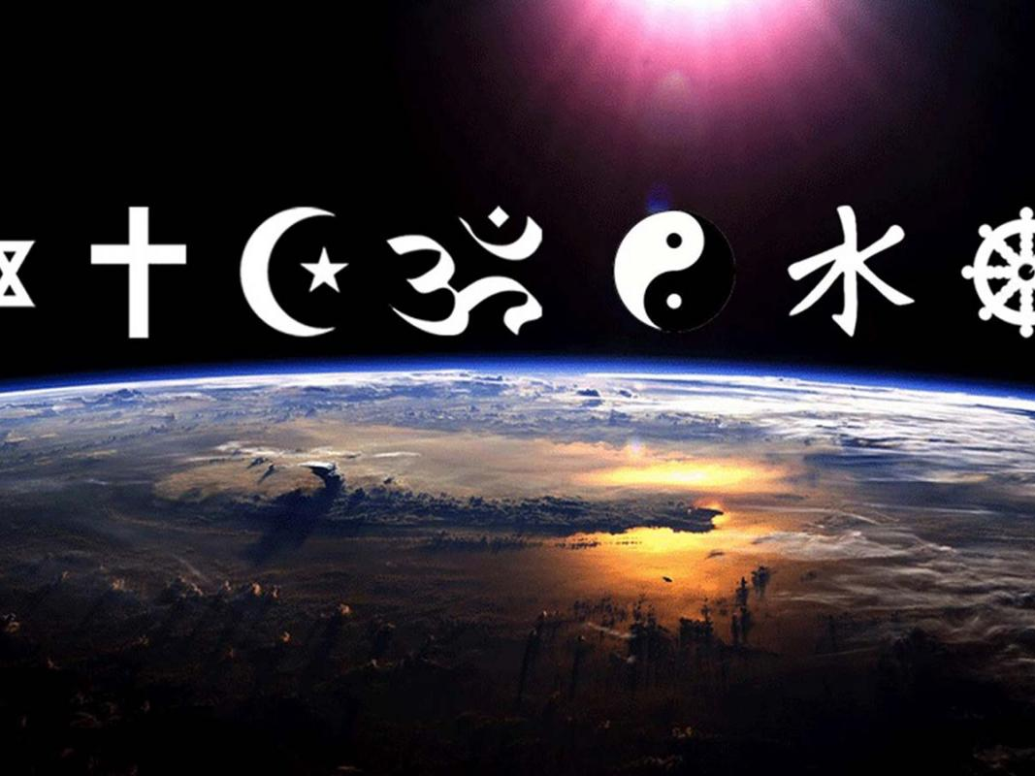
Religion
and a broken world

Slide 6
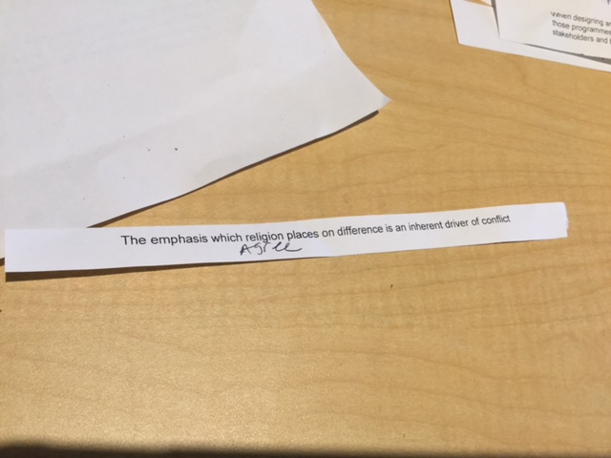

Slide 7
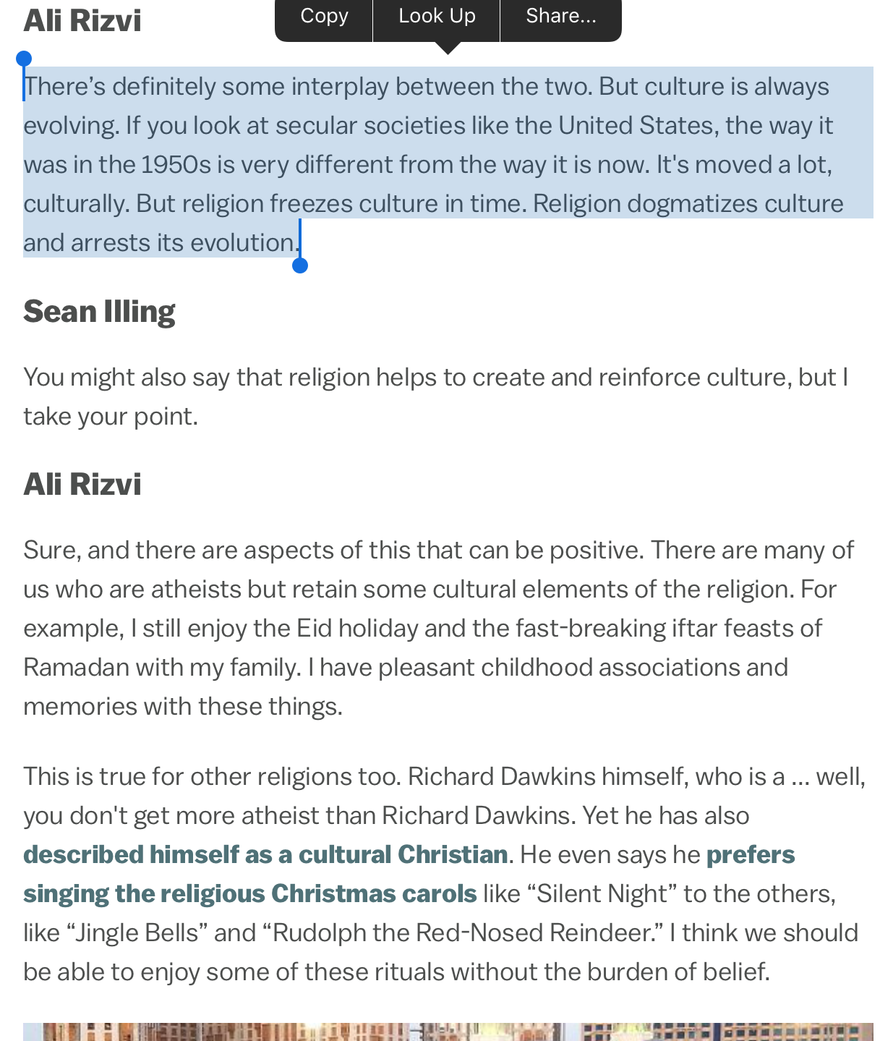
Religion is a major source of/reason for conflict worldwide.
Has it been a net positive for all its negatives, I don’t think so.
Religion + Power structures = Rigidity = Conflict
I am clear-eyed about its failings, and its faultiness.
And yet I am both “religious and spiritual”.

Slide 9
Pause for Thought
Belief and Balance:
The Politics of “Apology”

Slide 10
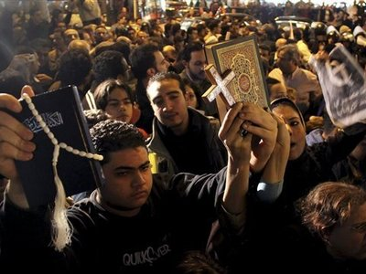
challenges
Some Historical Maturity
Encyclopedia of Wars, Charles Phillips and Alan Axelrod
1763 wars only 123 have been classified to involve a religious cause, accounting for less than 7% of all wars and less than 2% of all people killed in warfare
Metrics matter: Crusades, Inquisition, WW1
Ancient Wars? Egyptian, Babylonian, Persian, Greek, Roman, Mongol
"Modern" Conflict? French Revolution, Russian Revolution, Napoleonic Wars, American Civil War, WW1, WW2, Korea, Vietnam
Ideological Genocide? Stalin, Mao, Pol Pot, Rwanda

Slide 11
challenges
Religion as a Nexus for Human Experience
Distinctiveness, Difference, Truth Claims – can lead to conflict
Religion borne out of conflict or social rupture
Systematic ordering of the human experience
Finding our “origin story”
The messy intersections:
Politics & Power
Money & Wealth
Culture & Practice
Privileging the personal?

Slide 12
Pause for Thought
Religion as the driver of human conflict?
Answer: No.
Religion as a driver of human conflict?
Answer: Obviously. What do you think I am, an idiot?

Slide 13
The Second Interrogation
Why, then, do we continue to have faith?

Slide 14
Why then do I (continue to) believe?
The integrity of experience
that my faith, encountered through religion, has made me a better person, has helped me serve the world better.
Practice
Rituals and symbols that provide overwhelming meaning in a world that needs same.
Joy - a centered, coherent life worth living
I have told you this so that my joy may be in you and that your joy may be complete.
John 15:11

Slide 15
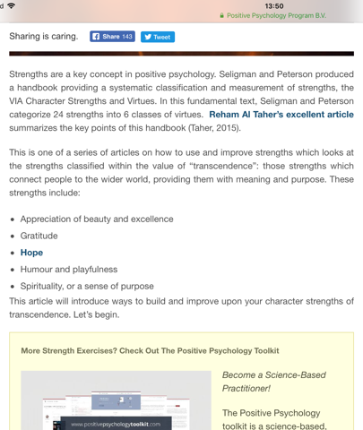
TRANSCENDENCE
The bliss that comes with oneness with the universe, with others, with self.

Slide 16
Anti Establishment Christianity
If Jesus were on earth today: “Oh wow, you guys made all I said and did into a religion?”
Founders of faith found them based on personal journeys and personal relationships from God.

Slide 17
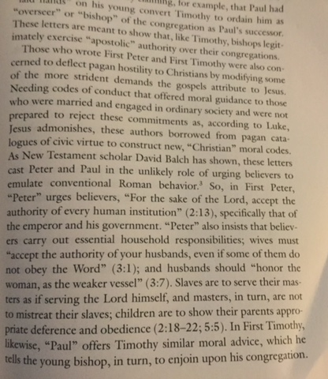
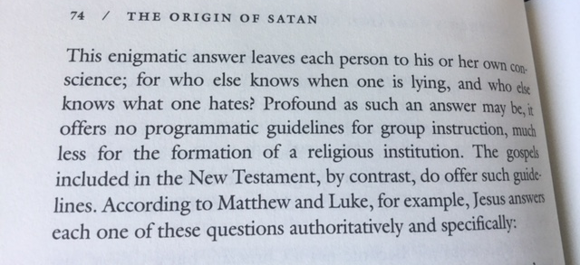
Often, the followers who institutionalize them interpret and structure them around typical power structures.

Slide 18
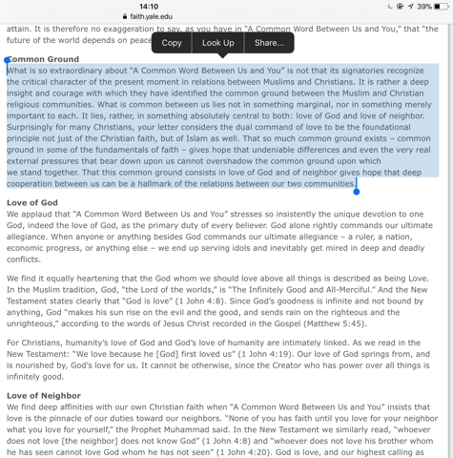
How do we preserve the central “truths” of faiths without other-ising the truths of others?
How do people retrieve the journey, the experience, in a way that’s personal and thus situational, relational and contextual?

Slide 19
Pause for Thought
Why do I Believe?

Slide 20
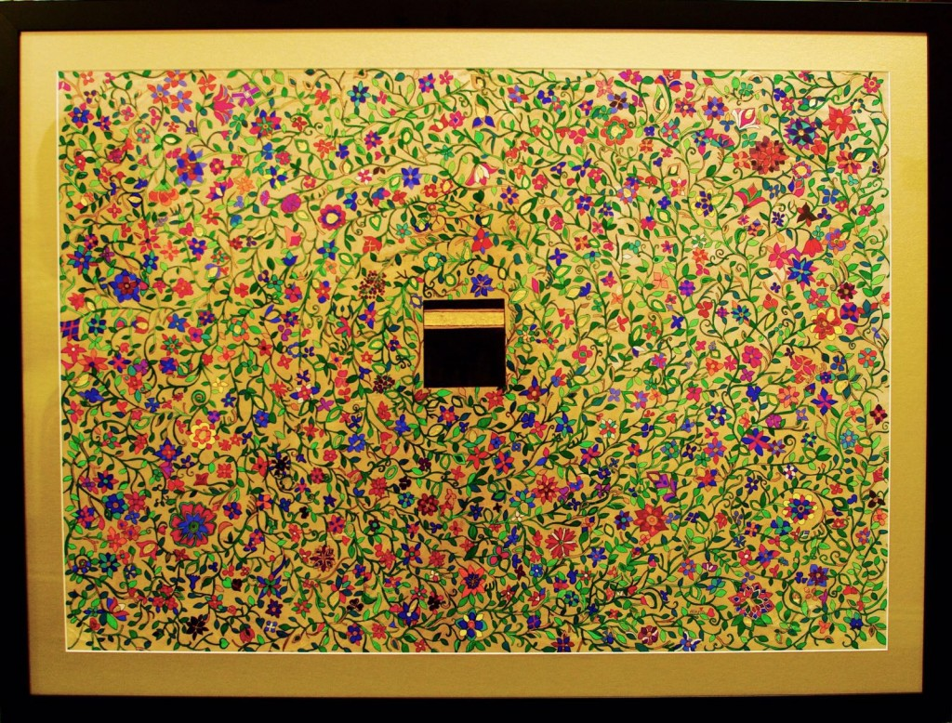
Pause for Thought

Slide 21
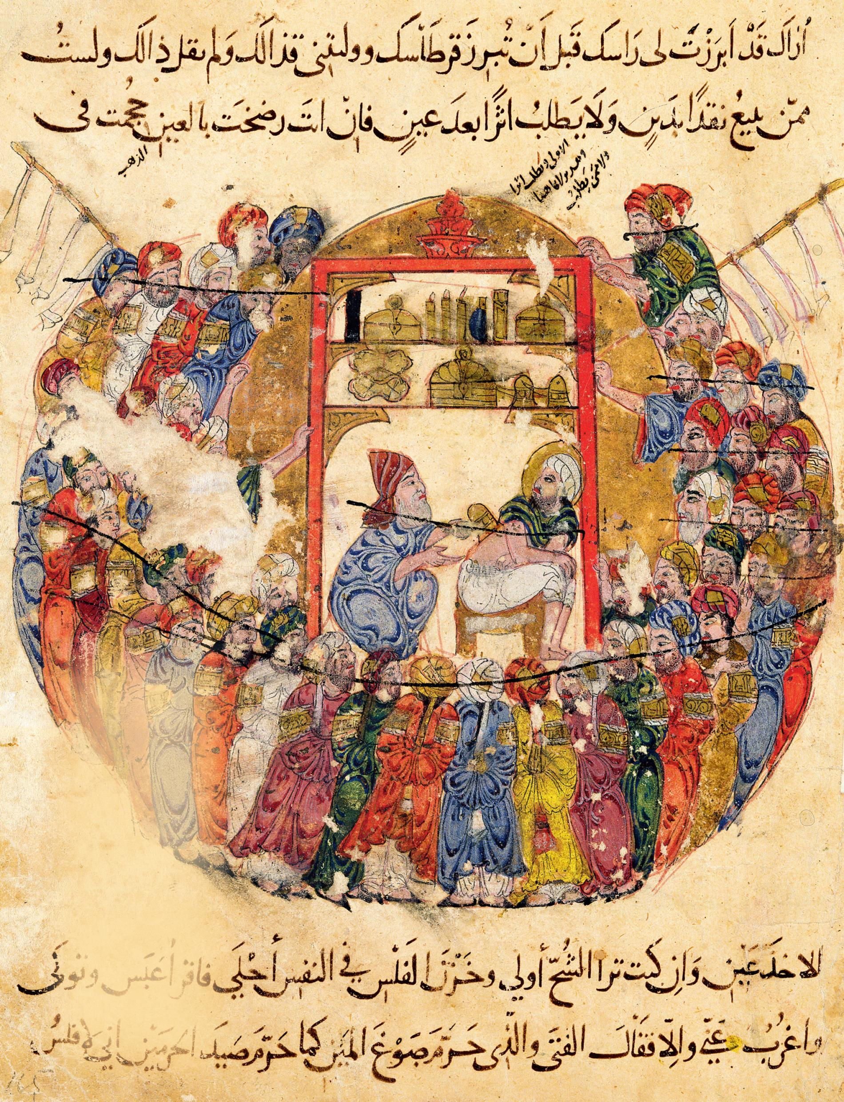

Slide 22
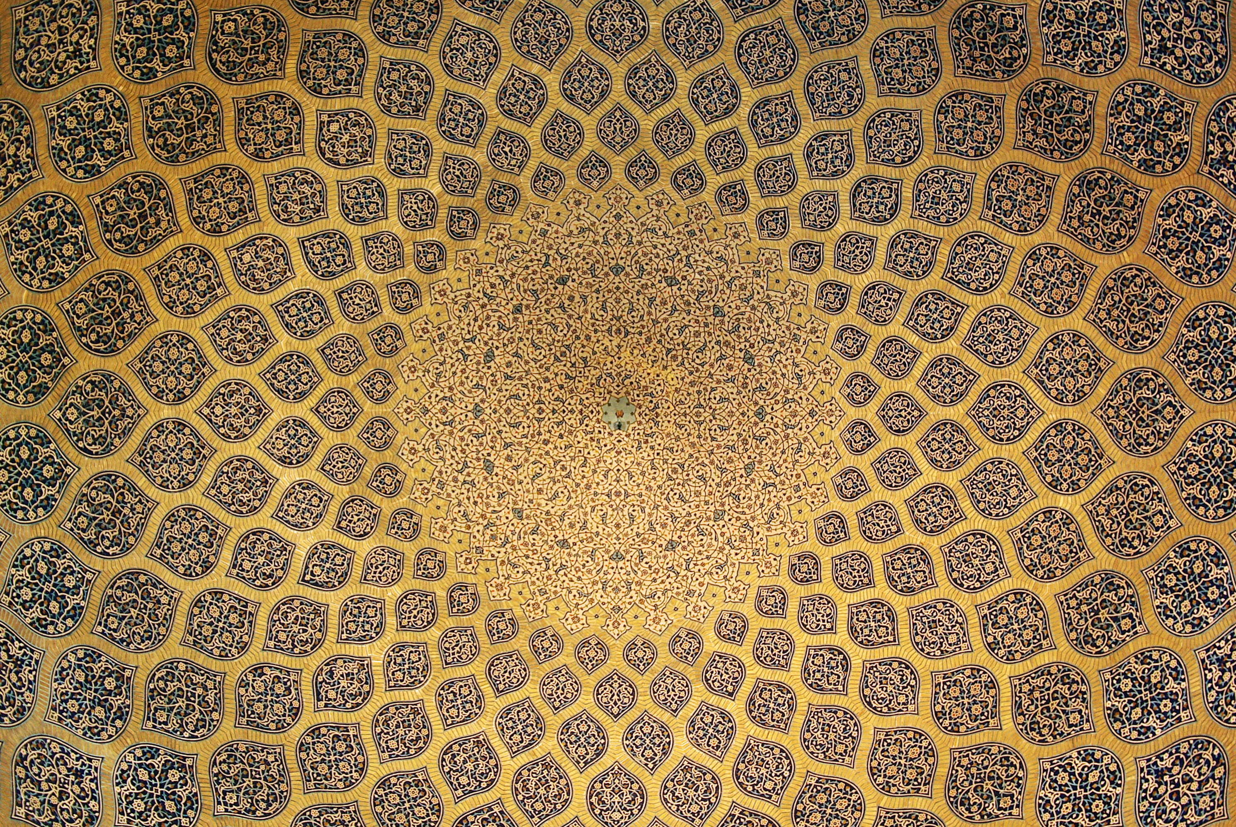

Slide 23
Pause for Thought
If I adore You out of fear of Hell, burn me in Hell!
If I adore you out of desire for Paradise,
Lock me out of Paradise.
But if I adore you for Yourself alone,
Do not deny to me Your eternal beauty.
Rabia of Basra, 8th Century

Slide 24
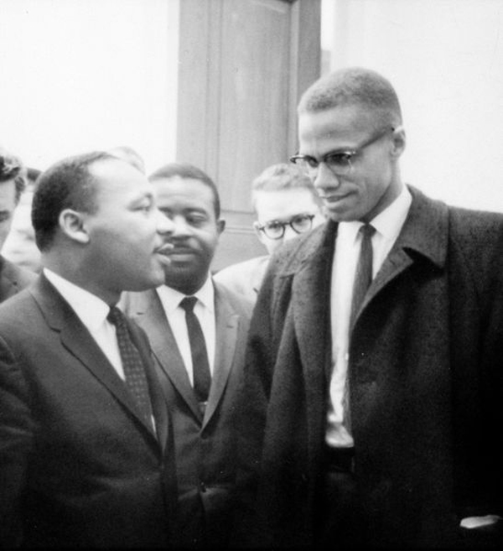

Slide 25
The third Interrogation
Where is our faith leading us?

Slide 26
Where my faith has led me
Joy Inc.
Again the integrity of experience. “Jesus led me to the science.”
How do we build a world where people functioning at the optimum - emotionally, socially and psychologically?
How do we completely overhaul the metrics of success so that people are able to live wholesome, fulfilling, ‘ubuntu’ lives?

Slide 27
James 1:26-27
Those who consider themselves religious and yet do not keep a tight rein on their tongues deceive themselves, and their religion is worthless. Religion that God our Father accepts as pure and faultless is this: to look after orphans and widows in their distress and to keep oneself from being polluted by the world.
How do we convert ‘religion’ into ‘faith’ again?

Slide 28
Mark 8:36
For what shall it profit a man, if he shall gain the whole world, and lose his own soul?

Slide 29
Pause for Thought
Faith, Culture and Social Justice…
Mercy as the Emblematic Principle of Humanity

Slide 30
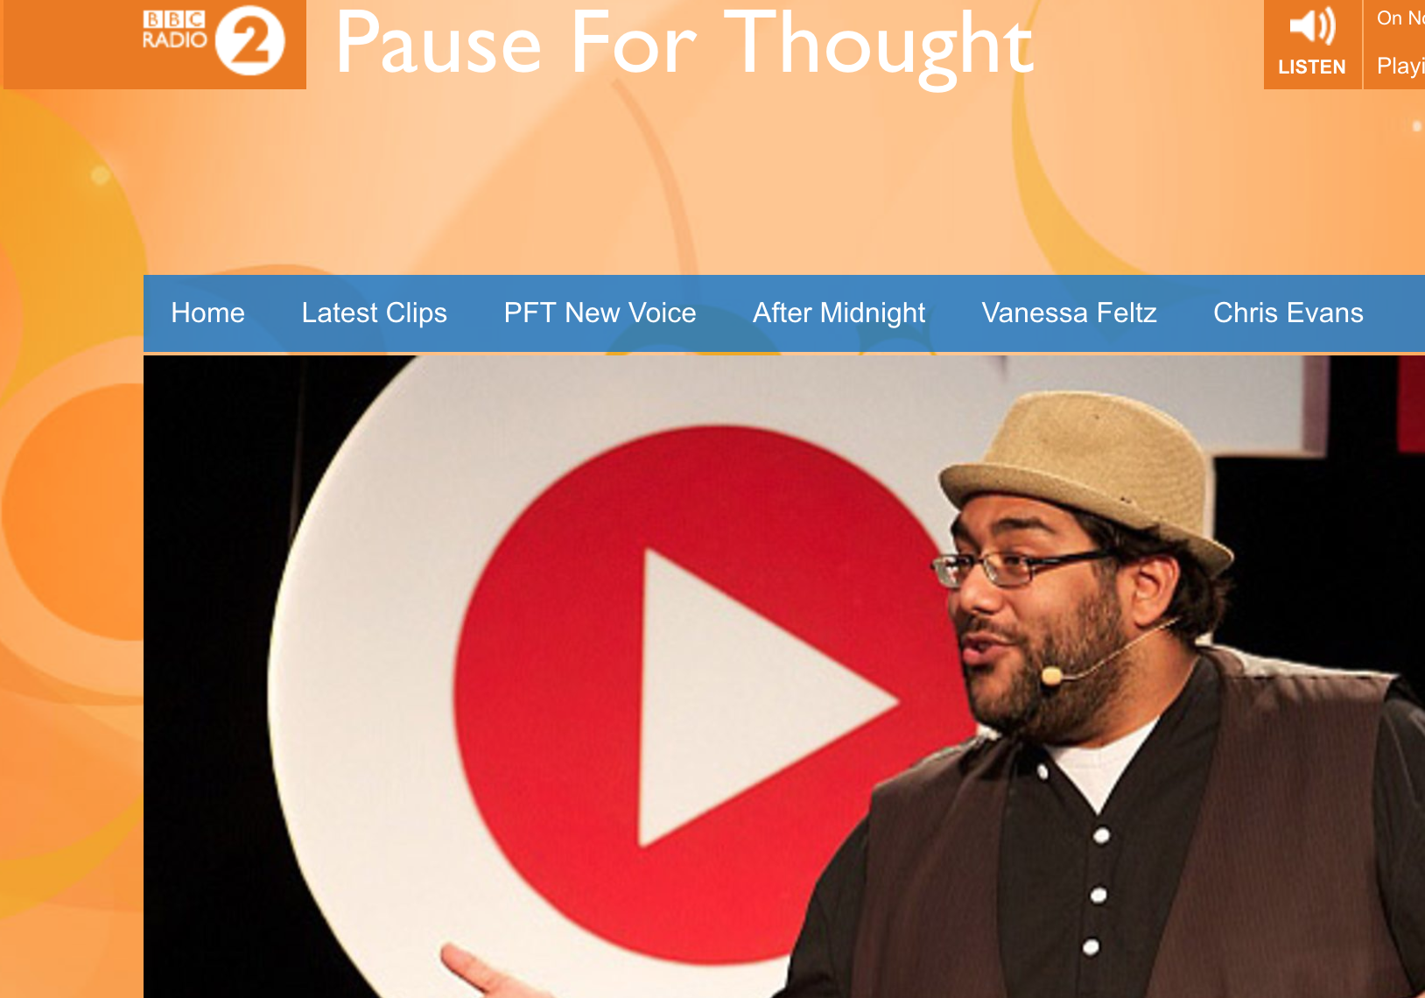

Slide 31
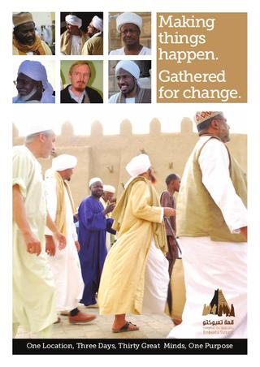
The Radical Middle Way
“Fight Fear. Fight Ignorance. Have Faith”
Dialogue and Engagement
Action and Service
Culture
Advancing Security

Slide 32
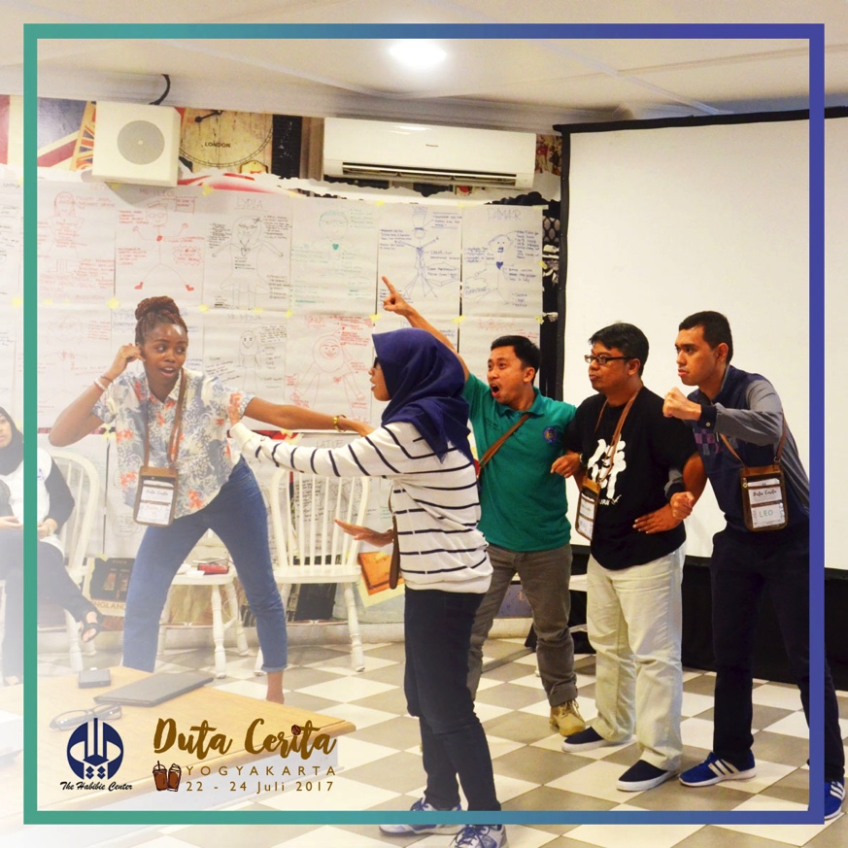
Pause for Thought

Slide 33
possibilities
#KafeCerita – Café of Stories
4 Pedagogies
Public Narrative: Self – Us- Now
Theater of the Oppressed
Interfaith Dialogue
Transformative Pedagogy: Multiple Identities
150 leaders, 5 conflict cities
Stories through Encounter
Digital Amplification

Slide 34
